Slide 1
Predictive Models
-Pricing Cars
Group 4
Mark Babbe, Camryn Callaway, Megan Chen, Korawat Tanwisuth, Claire Yang

Slide 2
Exploratory Data Analysis - Variables Inspection
Drop variable X
Factor level unsp in several categorical variables
Perfectly correlated variables:
(subTrim, fuel), (state, region)
Drop subTrim, state
Notes:
Mileage and year vs. price scatter plots show that there might be some polynomial relationship, which could be further examined in linear regression models
More aboutstate

Slide 3
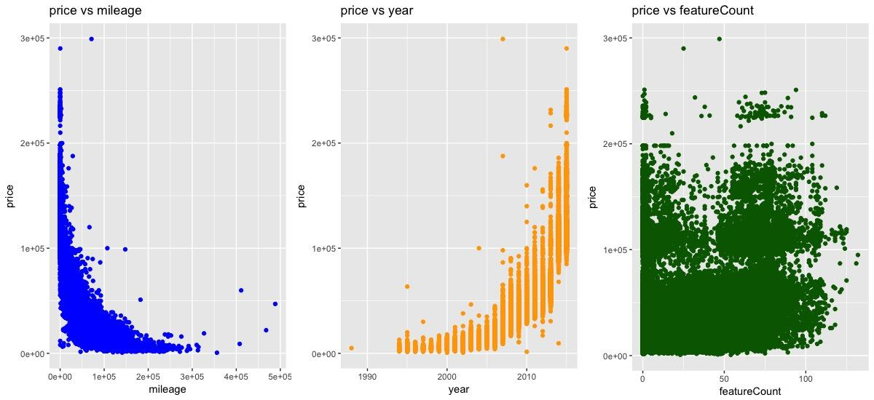
Exploratory Data Analysis - Numerical Predictors
Notes:
Mileage and year vs. price scatter plots show that there might be some polynomial (quadratic) relationship, which could be further examined in linear regression models
Will further discuss in stepwise regression
No strong pattern in featureCount

Slide 4
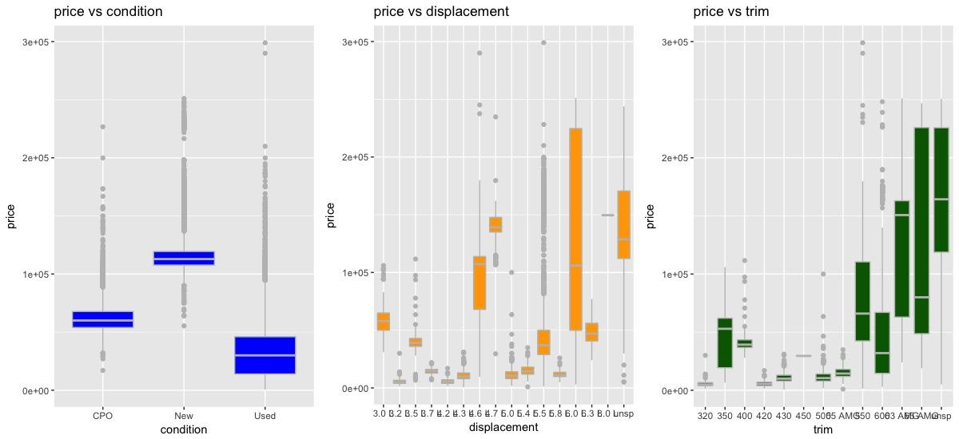
Exploratory Data Analysis - Categorical Predictors
Notes:
There exist many observations with factor “unsp.”
Box plots for each of the categorical predictors vs. price indicate that “unsp” itself as a category could be informative for price, so we keep it as a factor level
For our models, we divided out data in to 70 30 % for trrainign and testing set

Slide 5
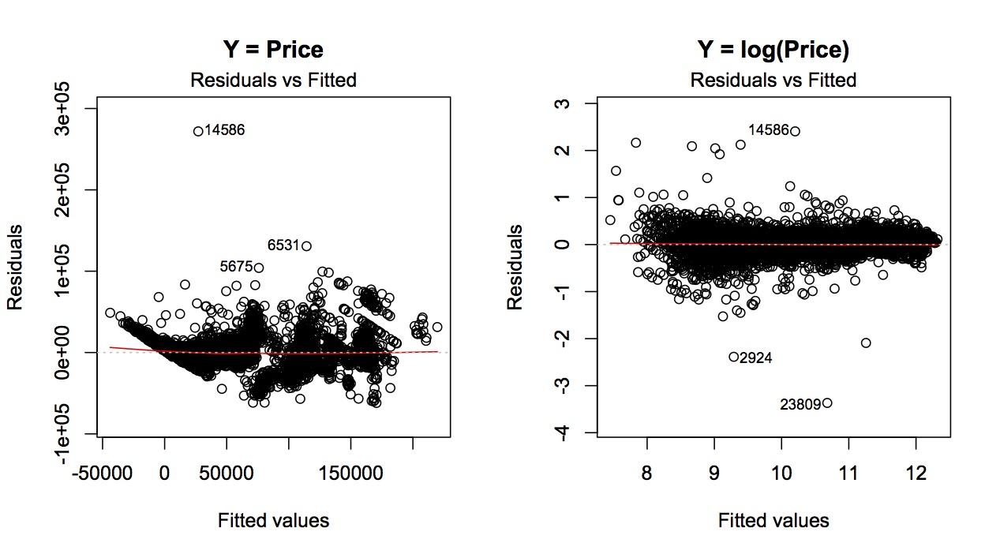
Linear Regression - Log Transformation
Notes:
Plot shows that there’s an increasing trend in residual for higher price values
Thus perform a log transformation on price Resulting residual plot shows a relatively random pattern, with significant reduction in RMSEo
When predicting price, we normally use log since the price fluctuates more when value goes up

Slide 6
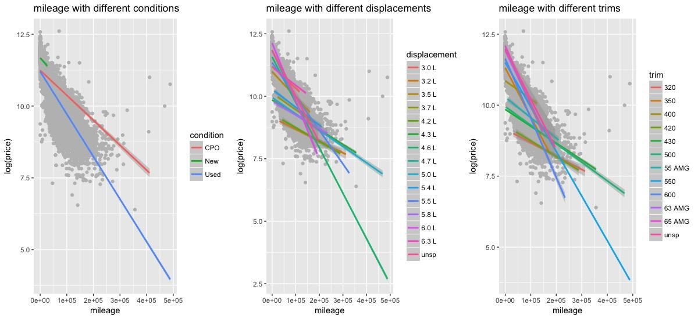
Linear Regression - Two-way Interaction
Notes:
Next we examined the potential two-way interactions, since the predictors consist a large portion of categorical variables
Mileage, as a numerical variable, with different conditions, displacements, and trims have different slopes, indicate significant interaction
Here are the interaction plots of
mileage*condition,
mileage*displacement,
mileage*trim

Slide 7
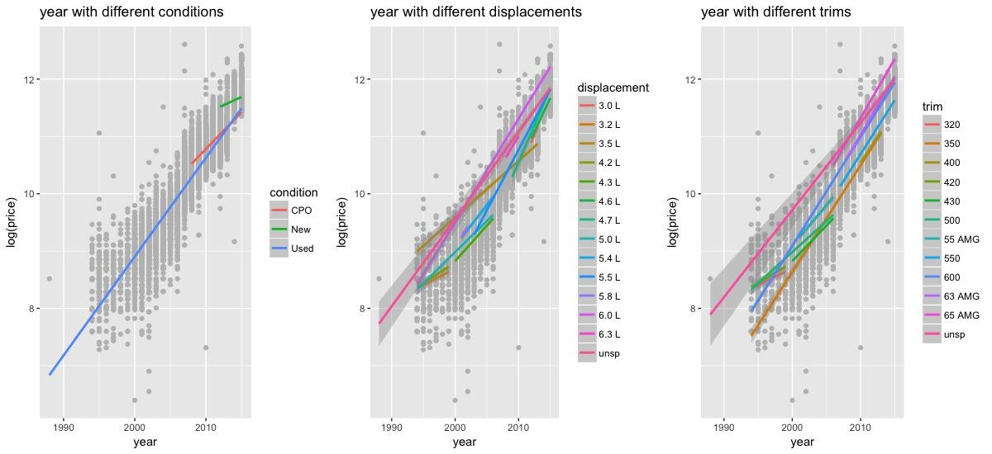
Linear Regression - Two-way Interaction
Notes:
Year, as a numerical variable, with different conditions, displacements, and trims have different slopes
Interaction plots indicate significant interaction
year*condition,
year*displacement,
year*trim

Slide 8
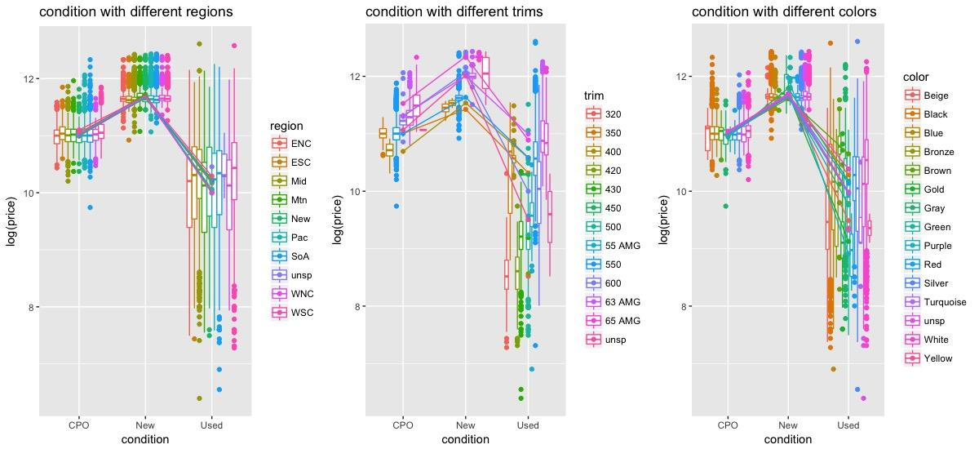
Linear Regression - Two-way Interaction
Notes:
Price doesn’t vary a lot for CPO and new, while it does for used
Interaction plots indicate significant interaction
condition*region,
condition*trim,
condition*color

Slide 9
Linear Regression - Variable Selection/Shrinkage Methods
Stepwise regression for second order terms
Forward selection
Backward selection
Ridge Regression
Lasso Regression

Slide 10
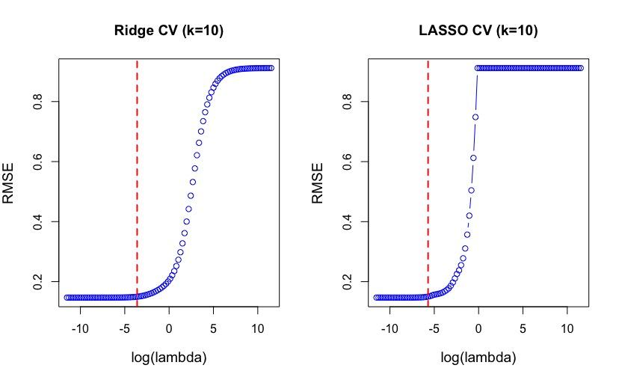
Linear Regression - Ridge vs Lasso (RMSE = 8568 vs 8216)

Slide 11
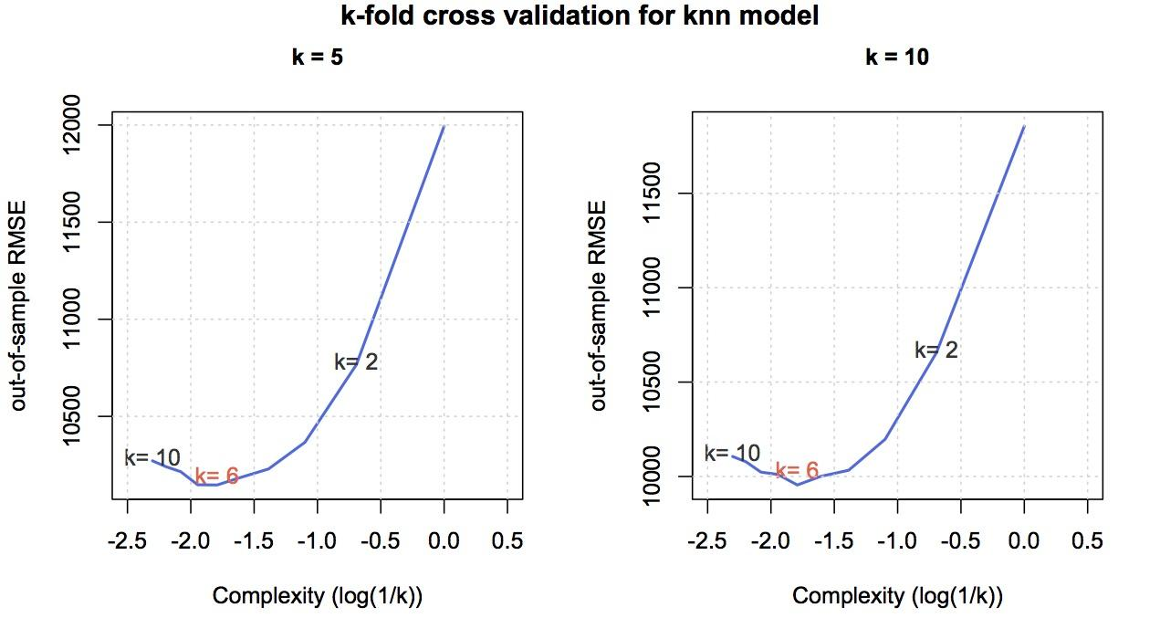
K-Nearest Neighbors (RMSE = 11097)
Notes:
To reduce bias: 3 numerical predictors are standardized.
Perform 5-fold & 10-fold cross validation to determine the best K
Cross-validated RMSE from both models suggest K = 6 for the lowest prediction error.
RMSEo is much higher than linear regression models as expected

Slide 12
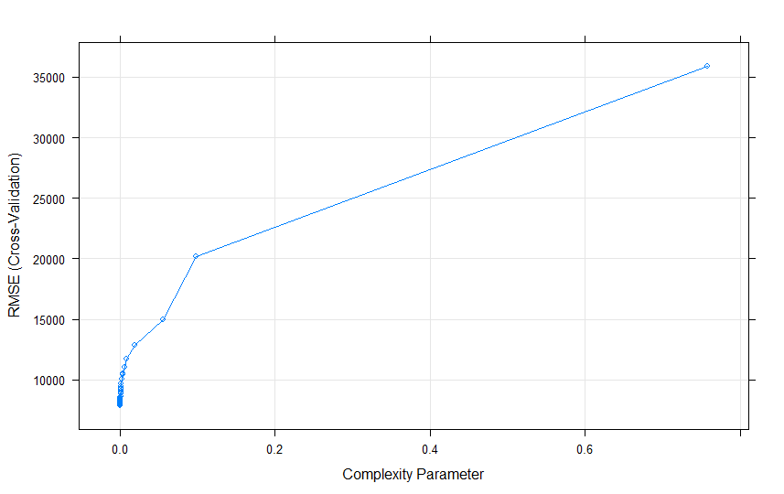
Tree Models - Single Tree (RMSE = 7654)
Notes:
Perform 10-fold cross validation to determine the best tree size (number of terminal nodes) for the lowest RMSE

Slide 13
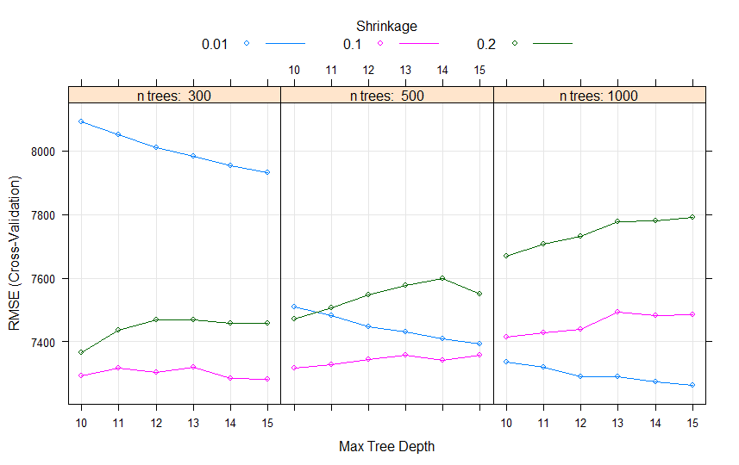
Tree Models - Boosting - (RMSE = 6845)
Notes:
Perform 5-fold cross validation to determine the best combination of number of split (interaction.depth), number of trees (n.trees) and λ (shrinkage)
Ntree = 1000 shrinkage = 0.01 depth = 15

Slide 14
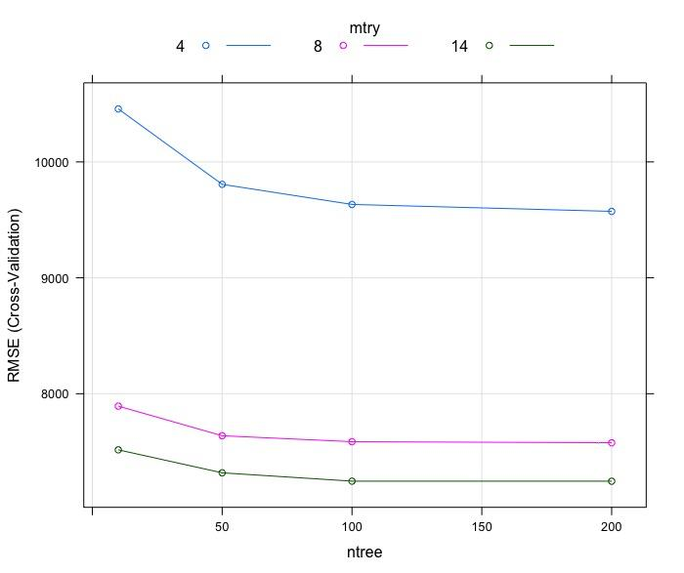
Tree Models - Random Forest - (RMSE = 6788)
Notes:
Perform 5-fold cross validation to determine the best combination of number of predictors (mtry) & number of trees (n.trees)
Mtry = 14 ntree = 200

Slide 15
Conclusion - Out-of-Sample RMSE
Model | Out-of-Sample RMSE (in descending order)
KNN | 11097
Ridge | 8568
Lasso | 8216
Tree | 7654
Boosting | 6845
Random Forest | 6788

Slide 16
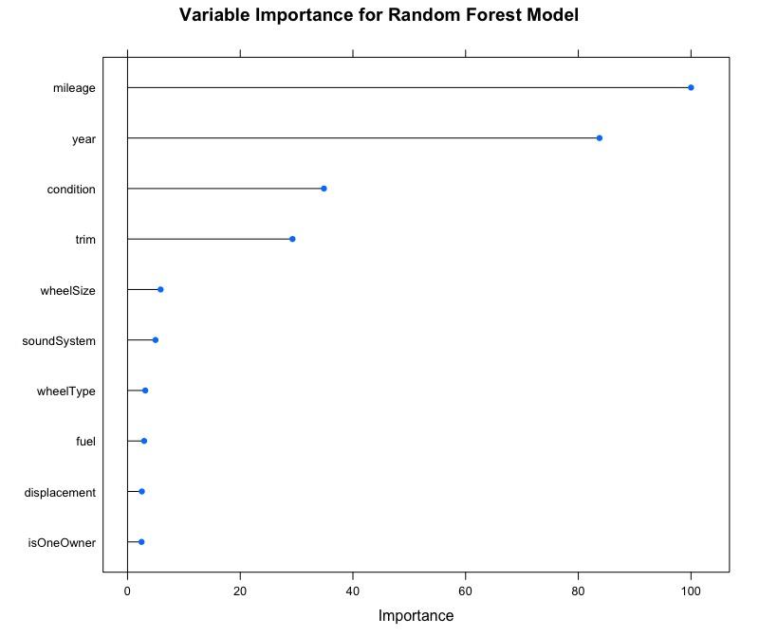
Conclusion - Variable Importance

Slide 17
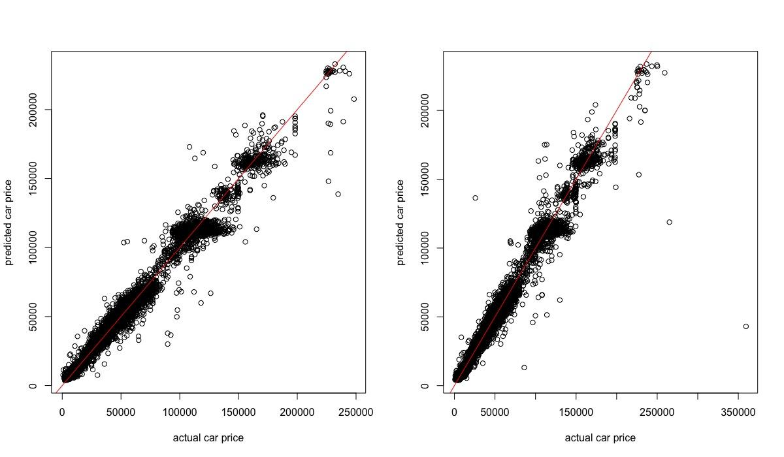
Conclusion - Final Prediction

